Slide 1
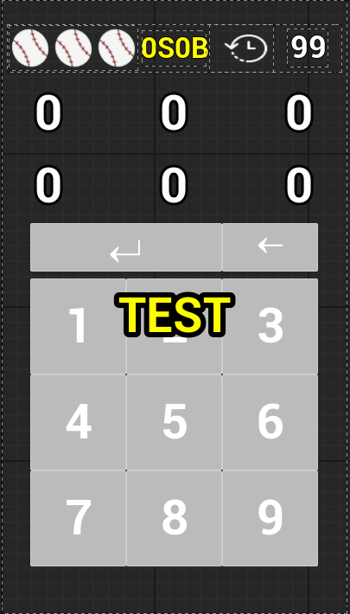



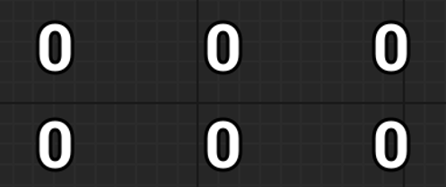


플레이어의 남은 턴 표시
제출 결과 표시
남은 턴 시간 표시
상대 플레이어의 입력 숫자 표시
내가 입력한 숫자 표시
제출 버튼
게임 결과 표시 텍스트
Game Widget

Slide 2
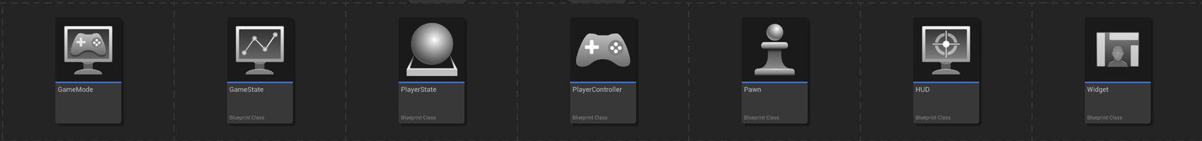
Client 0 (Host) | GameMode | GameState | PlayerState (Client 0) PlayerState (Client 1) | PlayerController (Client 0) PlayerController (Client 1) | Pawn (Client 0) Pawn (Client 1) | HUD (Client 0) | Widget (Client 0)
Client 1 |  | GameState | PlayerState (Client 0) PlayerState (Client 1) | PlayerController (Client 1) | Pawn (Client 0) Pawn (Client 1) | HUD (Client 1) | Widget (Client 1)
GameMode

Slide 3
Client 0 (Host) | GameMode | GameState | PlayerState (Client 0) PlayerState (Client 1) | PlayerController (Client 0) PlayerController (Client 1) | Pawn (Client 0) Pawn (Client 1) | HUD (Client 0) | Widget (Client 0)
Client 1 |  | GameState | PlayerState (Client 0) PlayerState (Client 1) | PlayerController (Client 1) | Pawn (Client 0) Pawn (Client 1) | HUD (Client 1) | Widget (Client 1)
GameMode

Slide 4
Client 0 (Host) | GameMode | GameState | PlayerState (Client 0) PlayerState (Client 1) | PlayerController (Client 0) PlayerController (Client 1) | Pawn (Client 0) Pawn (Client 1) | HUD (Client 0) | Widget (Client 0)
Client 1 |  | GameState | PlayerState (Client 0) PlayerState (Client 1) | PlayerController (Client 1) | Pawn (Client 0) Pawn (Client 1) | HUD (Client 1) | Widget (Client 1)
GameMode
“176”

Slide 5

Client 0 (Host) | GameMode | GameState | PlayerState (Client 0) PlayerState (Client 1) | PlayerController (Client 0) PlayerController (Client 1) | Pawn (Client 0) Pawn (Client 1) | HUD (Client 0) | Widget (Client 0)
Client 1 |  | GameState | PlayerState (Client 0) PlayerState (Client 1) | PlayerController (Client 1) | Pawn (Client 0) Pawn (Client 1) | HUD (Client 1) | Widget (Client 1)
GameMode
“176”

Slide 6
Client 0 (Host) | GameMode | GameState | PlayerState (Client 0) PlayerState (Client 1) | PlayerController (Client 0) PlayerController (Client 1) | Pawn (Client 0) Pawn (Client 1) | HUD (Client 0) | Widget (Client 0)
Client 1 |  | GameState | PlayerState (Client 0) PlayerState (Client 1) | PlayerController (Client 1) | Pawn (Client 0) Pawn (Client 1) | HUD (Client 1) | Widget (Client 1)
GameMode
“176”

Slide 7
Client 0 (Host) | GameMode | GameState | PlayerState (Client 0) PlayerState (Client 1) | PlayerController (Client 0) PlayerController (Client 1) | Pawn (Client 0) Pawn (Client 1) | HUD (Client 0) | Widget (Client 0)
Client 1 |  | GameState | PlayerState (Client 0) PlayerState (Client 1) | PlayerController (Client 1) | Pawn (Client 0) Pawn (Client 1) | HUD (Client 1) | Widget (Client 1)
GameMode
판단중..
“176”

Slide 8
Client 0 (Host) | GameMode | GameState | PlayerState (Client 0) PlayerState (Client 1) | PlayerController (Client 0) PlayerController (Client 1) | Pawn (Client 0) Pawn (Client 1) | HUD (Client 0) | Widget (Client 0)
Client 1 |  | GameState | PlayerState (Client 0) PlayerState (Client 1) | PlayerController (Client 1) | Pawn (Client 0) Pawn (Client 1) | HUD (Client 1) | Widget (Client 1)
GameMode
1S1B!
“176”

Slide 9
Client 0 (Host) | GameMode | GameState | PlayerState (Client 0) PlayerState (Client 1) | PlayerController (Client 0) PlayerController (Client 1) | Pawn (Client 0) Pawn (Client 1) | HUD (Client 0) | Widget (Client 0)
Client 1 |  | GameState | PlayerState (Client 0) PlayerState (Client 1) | PlayerController (Client 1) | Pawn (Client 0) Pawn (Client 1) | HUD (Client 1) | Widget (Client 1)
GameMode
1S1B!
“176”

Slide 10
